Slide 1


Dr. N.G.P. INSTITUTE OF TECHNOLOGY
Coimbatore - 48
(An Autonomous Institution)
(Approved by AICTE, New Delhi & Affiliated to Anna University, Chennai
Recognized by UGC & Accredited by NAAC A+ and NBA (CSE, BME, EEE, ECE and Mech) Dr.N.G.P. Nagar, Kalapatti Main Rd, Coimbatore, Tamil Nadu 641048
Ph No: 0422 - 236 9105, Fax: 04222369106, E-mail: info@drngpit.ac.in
DEPARTMENT OF INFORMATION TECHNOLOGY
22UIT404- MINI PROJECT-I
CardioCare: Machine Learning for Health Care
Guided By
Dr.B.HEMALATHA
ASP/IT
Team Members
MADHU MITHA S (710723205037)
PREETHA J (710723205045)
SUJIKA S (710723205058)
THIRUNAAVUKKARASU S (710723205060)
BAARGAVAN A (710723205302)

Slide 2
OUTLINE
Introduction
Objective
Literature Survey
Findings from Literature Survey
Proposed Methods/ Techniques/Algorithms
List of Modules
Hardware & Software Specifications
Expected Impact and contribution to the work
Preliminary Results
Individual Contribution to the work
Pending Works and plan for completion
Conclusion
References

Slide 3
INTRODUCTION
Background of the research:
The research focuses on improving heart disease prediction models by integrating the Jellyfish Optimization Algorithm (JFO) with Support Vector Machines (SVM). Traditional machine learning techniques such as Naïve Bayes and Decision Trees have been widely used for heart disease prediction, but they often face challenges like overfitting, small datasets, and inconsistencies in feature engineering. The study aims to enhance prediction accuracy by optimizing feature selection and hyperparameters through JFO​.
Problem statement:
Current machine learning models for heart disease prediction often struggle with accuracy, feature selection, and adaptability to real-world scenarios. Many existing methods, such as Naïve Bayes and Decision Trees, fail to generalize well due to overfitting, dataset limitations, and suboptimal hyperparameter tuning. To address these challenges, this research proposes an enhanced Support Vector Machine (SVM) model optimized using the Jellyfish Optimization Algorithm (JFO), aiming to improve prediction accuracy, feature selection efficiency, and model robustness for practical healthcare applications.

Slide 4
INTRODUCTION
Research Gap:
Existing models suffer from overfitting and small datasets, limiting their applicability.
Variability in feature selection methods affects model consistency and performance.
Many studies focus on theoretical improvements rather than real-world clinical deployment.
The impact of optimization techniques on SVM-based heart disease prediction remains underexplored.
Limited research on hybrid models combining optimization algorithms with SVM.

Slide 5
OBJECTIVE OF THE PROJECCT
To propose an effective machine learning-based approach for heart disease prediction using the Jellyfish Optimization Algorithm (JFO) and Support Vector Machines (SVM).
To enhance feature selection techniques by leveraging JFO to identify the most significant attributes, improving model accuracy and reducing computation time.
To optimize hyperparameter tuning in SVM using JFO, ensuring an improved classification model for heart disease detection.
To compare the proposed model with existing heart disease prediction models such as KNN, GradientBoosting, and standard SVM to validate its performance.
To analyze the impact of JFO-based optimization on model accuracy, recall, precision, and F1-score in predicting heart disease.

Slide 6
LITERATURE SURVEY
S.No. | Title of the Paper | Author Details | Publication & Year | Remarks
01. | Heart Disease Prediction Using Hybrid Machine Learning | Ahmed, Mohammed and Idress Husien | Journal of Robotics and Control (JRC) 5, no. 3 & 2024 | By merging several models, the study uses ensemble learning to forecast cardiovascular disease with higher accuracy. In order to train multiple models on large datasets, ensemble methods require more resources and are computationally costly and time-consuming.
02. | Improving Cardiovascular Disease Prediction through Comparative Analysis of Machine Learning Models | Anjum, Nishat, Cynthia Ummay Siddiqua, Mahfuz Haider, Zannatun Ferdus, Md Azad Hossain Raju, Touhid Imam, and Md Rezwanur Rahman | Journal of Computer Science and Technology Studies & 2024 | XGBoost delivers high accuracy and AUC making it a powerful tool for early myocardial infarction prediction and improving clinical decision-making. XGBoost may not work as well on smaller or unbalanced datasets and can be computationally costly.
03. | Enhancing Heart Attack Prediction with Machine Learning | Alshraideh, Mohammad, Najwan Alshraideh, Abedalrahman Alshraideh, Yara Alkayed, Yasmin Al Trabsheh, and Bahaaldeen Alshraideh | Applied Computational Intelligence and Soft Computing & 2024 | Early diagnosis are improved by the system's 94.3% increase in heart disease prediction accuracy with the use of PSO. Depending on the dataset or the features chosen, the performance of PSO feature selection might vary and adds computational complexity.

Slide 7
LITERATURE SURVEY
04. | Effective feature engineering technique for heart disease prediction with machine learning | Babu, Ch Kiran, M. Iswarya, R. Manikanta Kumar and M. Pavan Sai. | Journal of Nonlinear Analysis and Optimization & 2024 | Uses PCHF and decision trees to increase the identification of heart failure with high accuracy and the possibility of an early diagnosis. Different datasets may have different levels of effectiveness, and feature selection increases computational complexity.
05. | Cardiac disease risk prediction using machine learning algorithms | Stonier,Albert Alexander, Rakesh Krishna Gorantla, and K. Manoj. | Journal of Healthcare Technology Letters Published by Institution of Engineering and Technology & 2024 | Random Forest reduces the risk of overfitting through its ensemble approach, making it reliable in diverse datasets. The model's performance is heavily reliant on the quantity and quality of the training data; poor data can lead to inaccurate predictions.

Slide 8
06 | Heart disease prediction using distinct artificial intelligence techniques: performance analysis and comparison | Md. Imam Hossain, Mehadi Hasan Maruf, Md. Ashikur Rahman Khan, ce | Iran Journal of Computer Science June 2024 | Dependence on data quality and potential overfitting in complex models can limit generalizability. Complex models may overfit to the training data, resulting in poor performance on unseen data, thus reducing their generalizability in real-world scenarios.
07 | Image-Enhanced Heart Disease Risk Assessment using CNN Algorithm | Aneesa Malik, Huzaifa Anwar, AsadAbbas, HumayunSalahuddin, Huzaifa Anwar | Journal of Computing & Biomedical Informatics 2024 | A well-defined workflow and effective algorithms facilitate systematic analysis, enabling accurate identification and categorization of heart conditions The need for extensive preprocessing can be time-consuming and may require specialized knowledge, potentially complicating the workflow.

Slide 9
FINDINGS FROM LITERATURE SURVEY
Existing research highlights various approaches to solving the problem.
Some methods show promising results but lack real-world validation.
Certain techniques struggle with scalability and computational cost.
There is no single best approach; a combination of techniques may work better.
Limited studies explore the long-term impact of proposed solutions.
The findings help in identifying key factors for further study.
Recent studies suggest emerging techniques that could enhance performance.

Slide 10
PROPOSED METHODOLOGY ( Flow Chart)
Data collection
Data cleaning
Data Preprocessing
Feature Selection
Feature
Classification
Healthy Heart Disease

Slide 11
MODULES FOR PROJECT DEVELOPMENT
Data Collection
Data is sourced from publicly available repositories like UCI Machine Learning Repository and Kaggle.
The dataset includes attributes such as age, blood pressure, cholesterol levels, heart rate, and other clinical parameters relevant to heart disease prediction.
Data Preprocessing
Handling Missing Values: Imputation techniques are applied to manage incomplete data.
Normalization: Scaling techniques ensure consistent feature ranges.
Feature Selection
The features are selected using variance thresholding test.

Slide 12
MODULES FOR PROJECT DEVELOPMENT
Model Selection
Machine learning models such as Support Vector Machine (SVM), KNN, and GradientBoosting are considered.
Hybrid models like SVM-JFO improve prediction accuracy.
Model Evaluation
Performance is assessed using metrics such as accuracy, precision, recall, F1-score, and ROC curve analysis.
A confusion matrix is analyzed to determine model effectiveness.
Optimization
Jellyfish Optimization Algorithm (JFO) enhances feature selection and classification accuracy.
Hyperparameter tuning (Grid Search, Random Search) optimizes model performance.
Ensemble learning techniques boost predictive accuracy and stability.
12

Slide 13
HARDWARE AND SOFTWARE SPECIFICATIONS
Hardware Specifications
1. CPU: intel core i3
2. RAM: 8 GB
3. Storage: 256 GB
Software Specifications
1. OS: Windows.
2. Languages: Python .
3. Libraries:
ML: Scikit-learn,SVM,Gradeint Boosting,KNN.
Data: Pandas, NumPy.
4. Development Tools: Google colab.

Slide 14
EXPECTED IMPACT AND CONTRIBUTION TO WORK
Novelty of the Approach
Integration of Jellyfish Optimization Algorithm (JFO) with SVM: This novel combination enhances feature selection and hyperparameter tuning, leading to improved classification accuracy.
Comparison with Traditional Models: Unlike existing studies that focus solely on SVM or KNN, this research benchmarks JFO-SVM against KNN and GardinentBossting, offering a comprehensive performance evaluation.
Optimization-Driven Feature Selection: JFO ensures that only the most relevant features contribute to model learning, reducing computational complexity and improving generalization.
Advancement Over Existing Research
Addresses Overfitting Issues: Traditional models often suffer from overfitting, especially with small datasets. The JFO-driven feature selection reduces redundancy, leading to better generalization.

Slide 15
EXPECTED IMPACT AND CONTRIBUTION TO WORK
Enhanced Performance Metrics: By incorporating AUC, precision, recall, and F1-score, the study ensures a well-rounded evaluation, addressing limitations in previous works that relied primarily on accuracy.
Potential Applications
Clinical Decision Support: The model can assist doctors in early-stage heart disease prediction, reducing misdiagnosis.
Personalized Healthcare: The optimized model can be integrated into wearable devices and mobile apps, offering real-time risk assessment.
AI-Driven Medical Research: Researchers can leverage the JFO-SVM framework to explore predictive modeling in other diseases, such as diabetes and stroke prediction.
Telemedicine and Remote Healthcare: The model can be deployed in cloud-based healthcare platforms, enabling remote patient monitoring and early intervention.
15

Slide 16
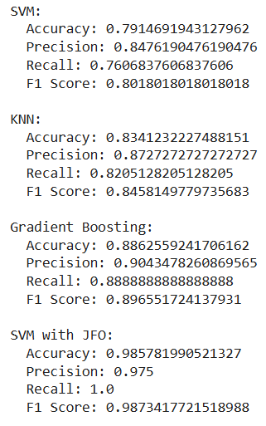
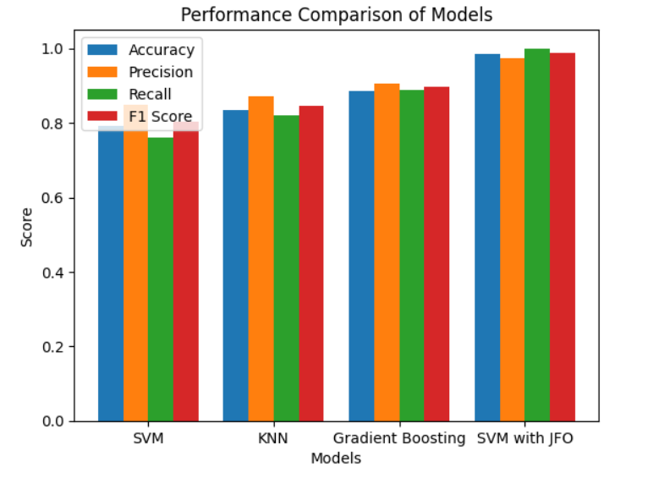
PRELIMINARY RESULTS

Slide 17
INDIVIDUAL CONTRIBUTIONS TO THE WORK
Batch Member 1 : MADHU MITHA S (710723205037)
Study relevant research papers and journals.
Extract key concepts, related work, and advancements.
Compare different methodologies for justification.
Develop and debug the Streamlit web application.

Slide 18
INDIVIDUAL CONTRIBUTIONS TO THE WORK
Batch Member 2 : PREETHA J (710723205045)
Design and prepare the PowerPoint presentation (PPT).
Ensure proper formatting, visuals, and clarity in slides.
Document key findings and explanations.
Study relevant research papers and journals.

Slide 19
INDIVIDUAL CONTRIBUTIONS TO THE WORK
Batch Member 3 : SUJIKA S (710723205058)
Study relevant research papers and journals.
Extract key concepts, related work, and advancements.
Design and prepare the PowerPoint presentation (PPT).
Structure the research paper content effectively.

Slide 20
INDIVIDUAL CONTRIBUTIONS TO THE WORK
Batch Member 4 : THIRUNAAVUKKARASU (710723205060)
Integrate Jellyfish Optimization Algorithm (JFO) + SVM model.
Optimize and test for performance.
Study relevant research papers and journals.
Write descriptions, methodology, and conclusions for reports and presentations.

Slide 21
INDIVIDUAL CONTRIBUTIONS TO THE WORK
Batch Member 5 : BAARGAVAN A (710723205302)
Search for new techniques and improvements to existing methods.
Identify potential applications and future work.
Explore alternative optimization methods for better results.
Study relevant research papers and journals.

Slide 22
PENDING WORKS AND PLAN FOR COMPLETION
1)Web Interface Development
Design a user-friendly UI using Streamlit to allow users to upload input data.
Add real-time visualization for input data and predictions.
2)Backend Integration
Load the trained Jellyfish Optimization Algorithm (JFO) + SVM model.
Implement a preprocessing pipeline to handle user-uploaded data.
3)Output Generation
Display the predicted results with confidence scores.
Generate performance metrics (accuracy, precision, recall, F1-score).
Include graphical representations (ROC curve, feature importance).

Slide 23
Status on Partial Completion and Submission of Project Report
List of Documents to be Submitted
SL.No | List of Documents | Status of Completion
1 | Cover Page & Title Page (Both are in same format)
2 | Bonafide Certificate
3 | Acknowledgement
4 | Abstract
5 | Chapter I – Introduction
6 | Chapter 2 – Literature Survey
7 | Chapter 2 – Software Requirement Specification
8 | References

Slide 24
REFERENCES
Journal
[1] Ahmed, Mohammed, and Idress Husien. "Heart Disease Prediction Using Hybrid Machine Learning: A Brief Review." Journal of Robotics and Control (JRC) 5, no. 3 (2024): 884-892.
[2] Anjum, Nishat, Cynthia Ummay Siddiqua, Mahfuz Haider, Zannatun Ferdus, Md Azad Hossain Raju, Touhid Imam, and Md Rezwanur Rahman. "Improving Cardiovascular Disease Prediction through Comparative Analysis of Machine Learning Models." Journal of Computer Science and Technology Studies 6, no. 2 (2024): 62-70.
[3] Alshraideh, Mohammad, Najwan Alshraideh, Abedalrahman Alshraideh, Yara Alkayed, Yasmin Al Trabsheh, and Bahaaldeen Alshraideh. "Enhancing heart attack prediction with machine learning: A study at jordan university hospital." Applied Computational Intelligence and Soft Computing 2024, no. 1 (2024): 5080332.
[4] BABU, CH KIRAN, M. ISWARYA, R. MANIKANTA KUMAR, and M. PAVAN SAI. "Effective feature engineering technique for heart disease prediction with machine learning." Journal of Nonlinear Analysis and Optimization 15, no. 1 (2024).
[5] Stonier, Albert Alexander, Rakesh Krishna Gorantla, and K. Manoj. "Cardiac disease risk prediction using machine learning algorithms." Healthcare Technology Letters 11, no. 4 (2024): 213-217.
[6]Md. Imam Hossain, Mehadi Hasan Maruf, Md. Ashikur Rahman Khan.”Heart disease prediction using distinct artificial intelligence techniques” Iran Journal of Computer Science & 23 June 2024 Volume 6, pages 397–417, (2024)
[7]Aneesa Malik,Huzaifa Anwar,AsadAbbas,Humayun Salahuddin,Huzaifa Anwar”Image-Enhanced Heart Disease Risk Assessment using CNN Algorithm”Journal of Computing & Biomedical Informatics Vol. 7 No. 01 (2024)

